Slide 1

Team Details
Team name: PANDA GANG
Team leader name: ROHAN DAS
Problem Statement: Civic Grievance Tracking Dashboard for Hyderabad Citizens and Students

Slide 2
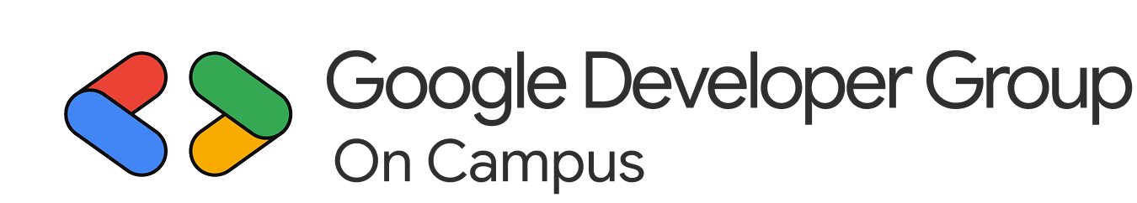
Problem Statement: Citizens and students in Hyderabad often face challenges in reporting and tracking civic issues such as potholes, waste management, water leakage, and streetlight failures. Existing grievance systems are fragmented, lack transparency, and provide limited feedback on issue resolution. This leads to frustration, inefficiency, and reduced civic participation among the public.
Proposed Solution: The Civic Grievance Tracking Dashboard is an AI-powered, data-driven platform designed to streamline the reporting, monitoring, and resolution of civic issues across Hyderabad. It empowers citizens and students to:
Report issues seamlessly through an intuitive web and mobile interface.
Track real-time progress of complaints using visual dashboards and status updates.
Enhance accountability by integrating with municipal departments and leveraging Google technologies for location tagging.
By centralizing communication between citizens and civic authorities, the dashboard fasters transparency, encourages community engagement, and contributes to a smarter, more responsive urban ecosystem.

Slide 3
Opportunities:
The Civic Grievance Tracking Dashboard introduces a unified, transparent, and data-driven approach to civic issue management, setting it apart from existing systems. Unlike traditional platforms that only record complaints, this solution integrates real-time tracking, AI-powered insights, and Google technologies to enhance efficiency and accountability. It consolidates multiple reporting channels into one centralized platform, enabling citizens and students to report issues with geotagged photos and track progress through interactive dashboards.
By leveraging Google Maps API, Firebase, and Google Cloud, the system ensures scalability, reliability, and seamless data synchronization. Its predictive analytics identify recurring issues and high-risk zones, allowing authorities to take preventive measures. The inclusion of gamified participation encourages civic engagement among students and citizens, fostering a sense of community responsibility. This solution effectively addresses the problem by streamlining complaint reporting, improving transparency, and ensuring faster resolution through automated routing and real-time updates. It empowers both citizens and civic authorities with actionable insights, promotes accountability, and transforms Hyderabad into a smarter, more responsive city.

Slide 4
List of features offered by the solution:
Unified Complaint Registration: A single platform for citizens and students to report civic issues such as potholes, garbage collection, water leakage, and streetlight failures through web and mobile interfaces.
Geo-Tagged Issue Reporting: Integration with Google Maps API enables users to pinpoint the exact location of an issue, ensuring accurate routing to the concerned department.
Real-Time Tracking Dashboard: Users can monitor the live status of their complaints, view progress updates, and receive notifications at each stage of resolution.
AI-Powered Complaint Categorization: Machine learning algorithms automatically classify complaints based on type, urgency, and location, reducing manual sorting and improving response time.
Data Analytics and Visualization: Interactive dashboards display trends, recurring issues, and departmental performance metrics, helping authorities make data-driven decisions.

Slide 5
Google Technologies used in the solution
Google Maps Platform: Used for geo-tagging complaints, visualizing issue locations, and mapping civic problem areas across Hyderabad.
Firebase: Powers real-time data synchronization, user authentication, and push notifications for instant complaint updates.
Google Cloud Platform (GCP): Provides the core infrastructure for hosting, data storage, and backend processing, ensuring scalability and reliability.
Google BigQuery: Enables large-scale data analysis to identify trends, recurring issues, and departmental performance metrics.
Google Data Studio / Looker Studio: Used to create interactive dashboards and visual reports for both citizens and civic authorities.
Google Cloud Identity and Access Management (IAM): Ensures secure access control for users, administrators, and civic departments, maintaining data privacy and system integrity.

Slide 6
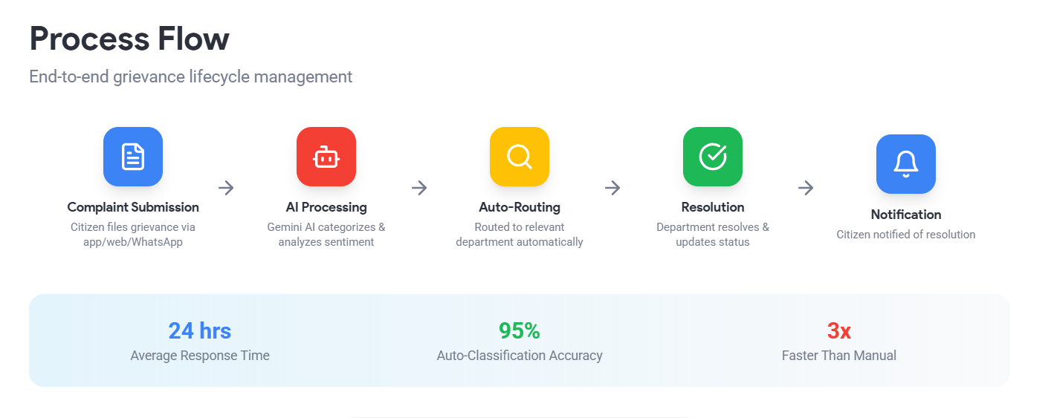

Slide 7
Wireframes
1. Citizen/Student Interface:
Home Screen: Options to Report Issue, Track Complaint, View Insights with a city map showing complaint hotspots.
Report Issue: Fields for title, category, description, photo upload,and auto-location tagging via Google Maps.
Track Complaint: Displays complaint ID, status (Pending/In Progress/Resolved), and progress bar for real-time tracking.
2. Department Dashboard:
View assigned complaints with filters by category and status.
Update or close complaints and upload resolution proof.
Analytics panel showing complaint trends and resolution times.
3. Admin Dashboard:
Overview of total complaints, user activity, and department performance.
Interactive charts for city-wide trends and resource management.
4. Feedback Screen:
Citizens rate service (1–5 stars) and add comments after resolution.The layout emphasizes ease of use, transparency, and real-time interaction between citizens, departments, and administrators.

Slide 8
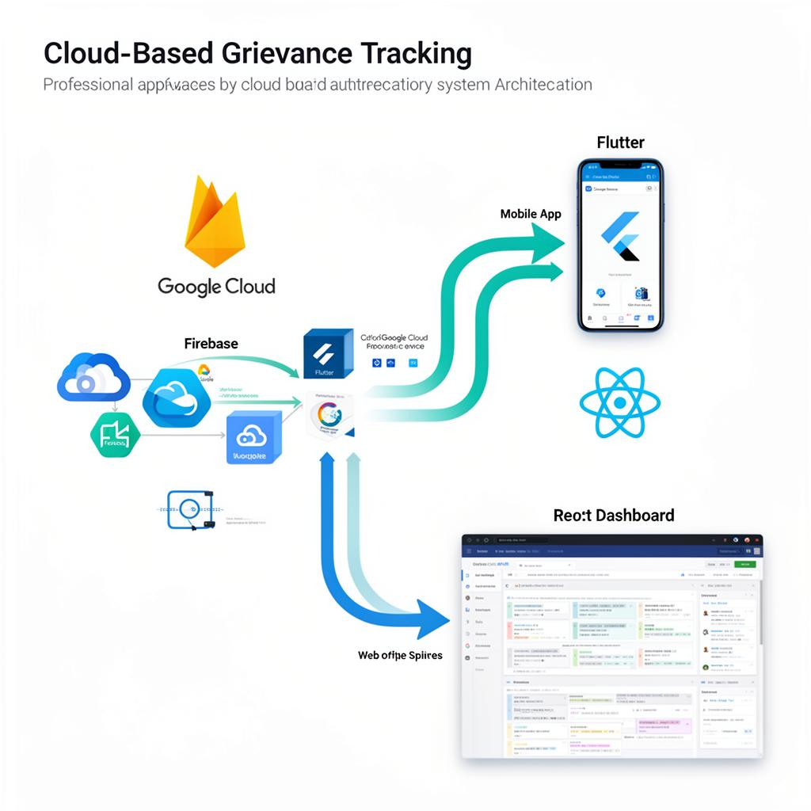
Architecture diagram of the proposed solution

Slide 9
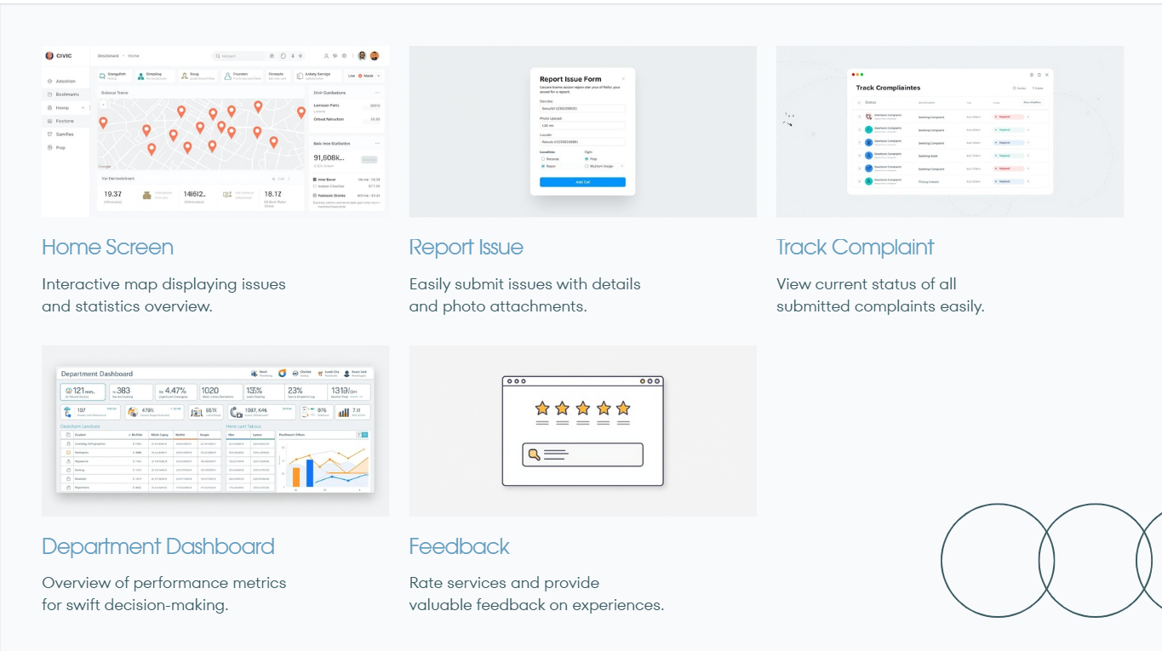
Snapshots of the MVP

Slide 10
Future Development
Technology Stack: The MVP is built using Firebase for authentication and real-time database management, Google Cloud for storage and analytics, and Google Maps API for location tagging and visualization.
User Roles: Three main user roles are defined Citizen/Student, Department Officer, and Administrator each with specific access levels and dashboards.
Data Flow: Complaints submitted by users are stored in the database, automatically categorized, and routed to the relevant department. Updates from departments are reflected in real time on the user’s dashboard.
Security Measures: Role-based access control, encrypted data transmission, and secure cloud storage ensure data privacy and integrity.
Scalability: The architecture supports easy scaling to other cities or regions by modifying configuration parameters without major structural changes.
Performance Monitoring: Built-in analytics track complaint resolution times, and user engagement to continuously improve service delivery.

Slide 11
Provide links to your:
GitHub Public Repository
Demo Video Link (3 Minutes)
MVP Link

Slide 12
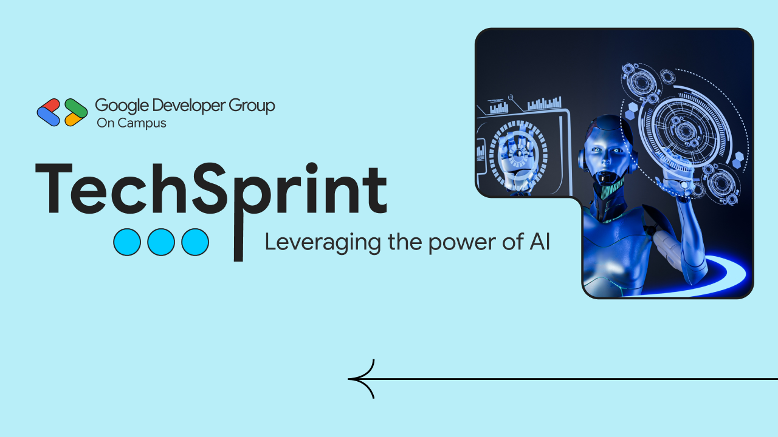
Thank you!

